Slide 1
Cybersecurity for Future Presidents
Lecture 12:
Applications of Cryptography and Trust Management:
Anonymity and Digital Currency

Slide 2
Any Questions?
My office hours:
Wed. afternoon, 12-3pm,
442 RH. Signup sheet circulating
About previous lecture?
About homework? (misc. exercises on storage sizes, scams, computational hardness, secure hash)
About reading? (D is for Digital - Algorithms)
Reading for next week: For bitcoin debate (both available on Canvas):
1. Bitcoin: Under the Hood. Communications of the ACM, Sept. 2015.
2. How A Credit Card is Processed. CreditCards.com.
Watch: Khan Academy overview of Bitcoin (11 minutes)
https://www.khanacademy.org/economics-finance-domain/core-finance/money-and-banking/bitcoin/v/bitcoin-overview
This is the first of a series of tutorial videos; watch others (e.g., secure hashing) if you wish
Exercises: Questions for debates

Slide 3
Cybersecurity events from the past week of interest to future (or current) Presidents:
E-mail:
Microsoft sues Justice Dept over secrecy orders to read emails on Fourth Amendment grounds
House judiciary committee votes unanimously for legislation to update ECPA to require warrants for access to email older than 180 days
More appeals courts side with government on warrentless cellphone tracking
Congressman Lieu complains that old SS7 vulnerability allowing eavesdropping of phone conversations remains unfixed
Administration appoints members to commission on enhancing national cybersecurity
US meets with Russia to prevent accidental cyberwar
Coming up: … ?

Slide 4
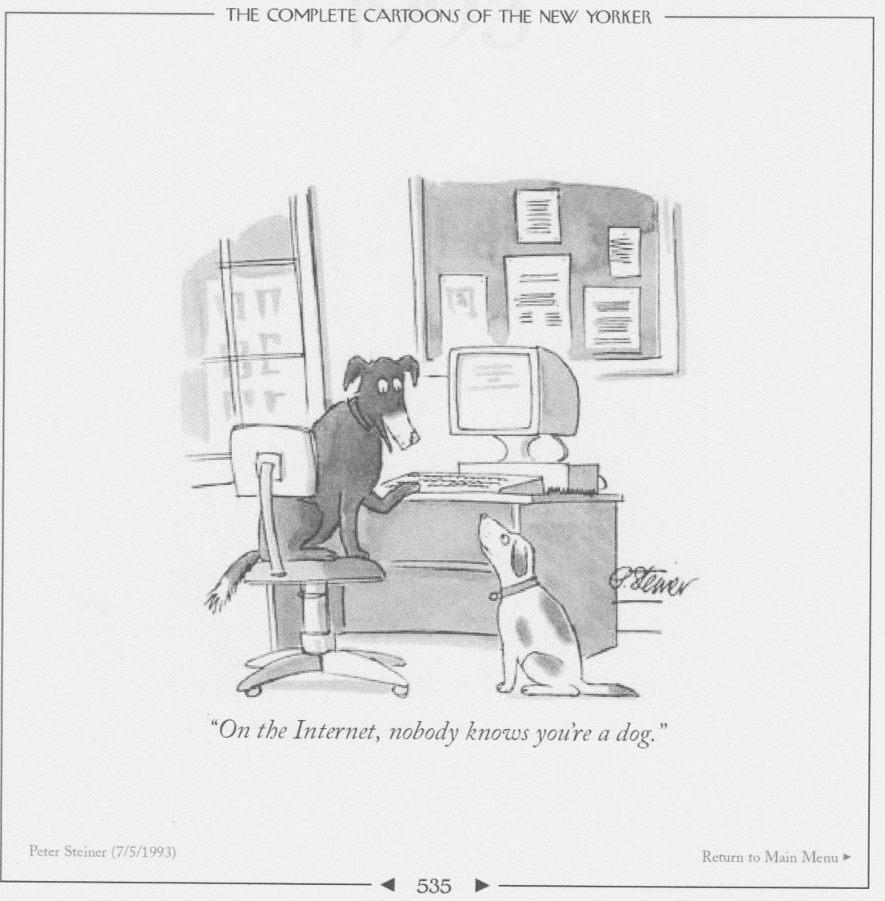
Anonymity on the Internet (1993)
“On the Internet, nobody knows you’re a dog”

Slide 5
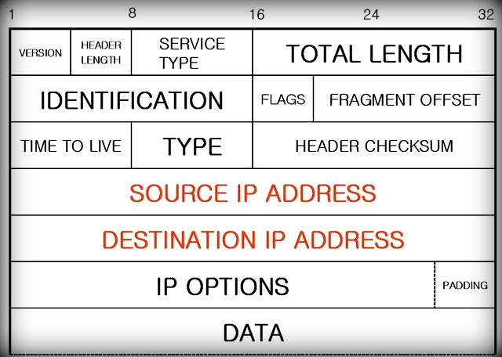
But how anonymous are you, really?
Internet packet header format:

Slide 6
In a packet-switched network, the routers must be able to read the packet headers
So the source and destination addresses (and other packet meta data) are normally in the clear
Even if the data in the packet is encrypted, much intelligence can be gained from the meta-data, for example:
Who is talking to whom?
How often?
What lengths of messages, in which direction?
So, the routers may not know you are a dog, but they can know the other IP addresses you are communicating with, how often, etc.

Slide 7
What is super-encryption?
M
It’s just encrypting a message that’s already encrypted:
If M = message, E_{k1}[M] is the message encrypted under Key k1
E_{k2}[E_{k1}[M] ] is M encrypted first under key k1 and then re-encrypted under key k2 (doubly encrypted)
To decrypt E_{k2}[E_{k1}[M] ], first remove the outer layer of encryption:
D_{k2}[E_{k2}[E_{k1}[M] ] → E_{k1}[M]
Then remove inner layer of encryption:
D_{k1}[E_{k1}[M]] → M
Think of this as simply a set of nested envelopes.
Each time you add a layer of encryption, you’ve created a new (outer) envelope.
M

Slide 8
What is a (Chaum) Mix? (Or, how to use superencryption for anonymity
In 1981 David Chaum published a scheme that would support anonymous email over the Internet, using what he called a Mix
Think of the Mix as a single node that has a public key PKM and secret key S_{M}
Other nodes also have public/secret key pairs. The setup:
Sender A
Public Key PKA
Receiver N
Mix
Public Key PKM Secret key SM
Receiver O
Sender B
Receiver P
Sender C
. . .
. . .
Receiver Z
Public Key PKZ
Sender H

Slide 9
How to send a message anonymously from A to Z
A encrypts the message under Z’s public key, making E_{PKZ}[M]
A adds Z’s address and encrypts the whole thing under the Mix public key: E_{PKM}[Z, E_{PKZ}[M]] and sends to the Mix
The Mix decrypts with its secret key, extracts the destination address and the (still encrypted) message for Z and forwards to Z:
D_{SM}[E_{PKM}[Z, E_{PKZ}[M]] = Z, E_{PKZ}[M]
Z receives and uses its secret key to decrypt:
D_{SZ}[E_{PKZ}[M]]
Z gets the message but only sees IP address of the Mix
Sender A
Public Key PKA
Receiver N
E_{PKM}[Z, E_{PKZ}[M]]
Mix
Public Key PKM Secret key SM
Receiver O
Sender B
Receiver P
Sender C
E_{PKZ}[M]
. . .
. . .
Receiver Z
Public Key PKZ
Sender H

Slide 10
Some issues with this scheme
Timing: Observer might be able to watch traffic enter and exit the Mix node and figure out from the timing and message lengths who is communicating with whom
Solution:
batch the traffic: Mix waits for sufficient number of messages to accumulate and then sends them all back out in a burst.
Also, chop/pad traffic so it’s all fixed length blocks
Guessing messages: Observer could perhaps encrypt messages likely to be sent under the public keys of possible recipients and might recognize the traffic
Solution: add “salt” (a random number) to the message before encrypting it; recipient removes the salt after decryption
Single Mix node is a central point of failure
Make it a MixNet (see next slide) – this also makes it harder to execute timing attacks

Slide 11
A Mix-net
Idea: add more layers of encryption and let traffic bounce among Mix nodes before being delivered
Sender A
Public Key PKA
Receiver N
Sender B
Mix
Mix
Receiver O
. . .
. . .
. . .
. . .
Sender C
Receiver P
. . .
Mix
Mix
. . .
Sender H
. . .
. . .
. . .
. . .
Receiver Z
Public Key PKZ

Slide 12
How does Onion Routing (Tor) work?
Original goal for Onion Routing was to enable traffic flow security for military communications, including web-browsing over the Internet – not for anonymity between end points
Tor is essentially a large mix-net, but with some developments
“Onions” are constructed by sender using public keys to initiate a connection within the Tor network that uses symmetric-key crypto (faster) for the subsequent traffic
Mixes were designed to work with email (non real-time)
Tor wants to support web-browsing, so can’t delay traffic too much
Consequently may be possible to detect correlations in traffic flow. The hope is that if there is enough traffic, it will be hard for opponents.

Slide 13
Connection Setup
B
C
F
A
D
E
Proxy
Core Onion Router
The initial proxy knows the Onion Routing network topology, selects a route, and generates the onion
Each layer of the onion identifies the next hop in the route and contains the cryptographic keys to be used at that node.

Slide 14
Data Movement
As data moves through the anonymous connection, it looks different at each onion router.
A message M sent from an initiator to a responder via a 5-hop onion route will change as follows:
The initiator pre-crypts M giving: E(E(E(E(E(M)))))
Entering A, the message will look like: E(E(E(E(E(M)))))
Entering D, the message will look like: E(E(E(E(M))))
Entering B, the message will look like: E(E(E(M)))
Entering C, the message will look like: E(E(M))
Entering F, the message will look like: E(M)
The responder receives: M
M
Initiator
√
A
D
B
C
F
Responder
M
M
M
M
M
M

Slide 15
What happened
Prototypes developed and demonstrated (late 1990s)
One of the inventors (Syverson) pushes to open source the technology (late 1990’s to early 2000’s)
Continues to push for full scale development
Additional funding and personnel located to continue the development
Deployment of full scale technology (2005+, I think)
Picked up by State Department as enabling dissent, free speech
Picked up by criminals as enabling cloaking of illegal markets (Silk Road)

Slide 16
Conventional payment processing (credit cards)
Players:
credit reporting agencies (Experian, Equifax, TransUnion)
Collects reports of payment history, % of credit limit used, total balances/debt, inquiries
credit scoring agencies (FICO, VantageScore) draw on credit reports, predict how likely creditor is to meet obligations
card issuer (issuing bank) decides to issue card to custorer
card holder, buys things with the card and makes payments
merchant, accepts the card for payment
acquiring bank/processor, reimburses the merchant

Slide 17
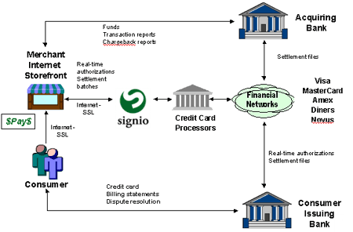
How transactions work – credit cards
¢
￠
¢
¢
¢ = a little fee here, and a little “digital dust”
¢

Slide 18
Trust relationships – credit card transaction
Cardholder: trusts merchant and payment processing infrastructure with credit card number (not to lose or abuse it)
Merchant: effectively gets a loan from bank until transaction settles; trusts that the transaction will settle
Banks trust the customer to pay and the merchant to deliver (to avoid chargebacks)
The payment processing system, which effectively maintains the Ledger, represents a Trusted Third Party: something that both cardholders and merchants must trust to not allow unauthorized transactions or drain accounts
Cardholder and bank also trust merchants not to reveal credit card info it may have stored
Ledger (simplified, one of several)
Account | Amount | Payee | Product | Account | Amount | Payer
Carl | -$28 | Amazon | Book | Amazon | +$28 | Carl

Slide 19
Underlying technologies and information flows – credit cards
Encryption:
Secure information in transit, (and sometimes information at rest (in files, databases))
Digital signatures for data integrity
Databases: to store transaction information (ledgers), customer data, credit cards, etc.
Card mag stripes or “chip and PIN” (which can reduce trust in merchant’s point-of-sale operation
Trusted Third Parties

Slide 20
Digital currency
General characteristics –
Anonymous or pseudonymous, private/untraceable
Irreversible, accountable transactions
Integrity: no forgery/duplication
General problems:
double spending
Theft/loss of keys involved
Lack of incentive for existing institutions to adopt them
History
1983 David Chaum (the same one) published an scheme for electronic cash based on blind signatures
1989 Chaum started a company, Digicash, to commercialize this, but it went bankrupt in 1998. Credit cards won out for ecommerce.
2008 “Satoshi Nakamoto” publishes “Bitcoin: A Peer-to-Peer Electronic Cash Systems” and in 2009 provides a reference implentation of software for it

Slide 21
Bitcoin Philosophy and Technologies
Underlying Philosophy
No central authority, everything decentralized
Growing pool of currency, but with a finite limit
Underlying technologies
Public key cryptography (Asymmetric crypto)
Encryption: Secure hashing (one-way functions)
Block Chain: single ledger for all transactions, widely replicated

Slide 22
Bitcoin Elements and Status
P2P communication network
Transactions and Blockchain
Mining and Consensus
Blockchain provides a single ledger that records all bitcoin transactions worldwide
The number of bitcoins in circulation increases slowly over time until the maximum number of coins(about 21,000,000) is reached (by about 2040). About 15M currently in circulation
Current price of a bitcoin in dollars; about $420-$430
See https://blockchain.info/ for current transactions

Slide 23
Properties of the ledger
Holds all the transactions
Transactions can’t be altered after the fact
Transactions can’t be inserted after the fact
Only agreed-upon transactions are added
How to assure these properties with digital data structure?

Slide 24
Bitcoin Basics: Transactions
Transactions:
Alice wants to send Bob some bitcoin
Alice creates transaction that includes
Inputs: bitcoin transactions that sent bitcoin to Alice
Outputs: number of bitcoins to transfer to Bob (and others)
“Alice” and “Bob” are really just account numbers (i.e., hashes of public keys).
Being able to sign with private key means you “own” that account.
Accounts can be created anytime by any participant, by generating a new public/secret key pair
A broadcasts the proposed transaction to the entire bitcoin P2P network
A new transaction becomes real when it is incorporated into the Blockchain – a chain of all bitcoin transactions, ever (see next slide)

Slide 25
Bitcoin basics: “Mining” and consensus
How does a new transaction get added to the blockchain?
There is no central authority to perform this operation (having one would mean it would be able to “censor” transactions, charge high fees, etc. – it would become powerful and trusted
Instead, there are many bitcoin nodes (i.e. computer systems running bitcoin mining software)
Each listens for new transactions, collects them over a short period, and makes them into a new “Block”
Miner checks that proposed transactions are valid (signatures are right, no double spending in relation to existing blockchain, etc.)
Miner must find a block: new transactions, hash of prior blockchain, and an arbitrary “nonce” value that has a secure hash value smaller than some specified number

Slide 26
What the miner is racing to do:
Mining Task:
Compute Hash of the Block Header for different values of “Nonce” until you find a hash that is numerically less than the difficulty target
(i.e., it has a specified number of leading zeroes)
When you find it, broadcast the block with the lucky “Nonce” you found and you win@!
Possible New Block to be added to the chain
Hash of prior block
Block Header
Hash of new transactions
Difficulty Target
Nonce
New Transactions
Block Body

Slide 27
Why would anybody play this game?
The winning miner gets paid in two ways:
It gets to keep some new bitcoins
It gets to keep the transaction fees from this block
(transactions for both of these payments were included in the block of new transactions)

Slide 28
What’s the benefit?
The validity of the new block can be checked by anyone
We have a way to achieve consensus on the contents of the global blockchain without resorting to a trusted third party

Slide 29
Some issues with Bitcoin
Key management:
Where do I store my private keys?
If I lose my private key I’ve lost the ability to do transactions on that account
If somebody steals my private key they can do transactions for me
Consensus:
It’s possible for two miners to propose new valid blocks at about the same time. This can lead to “forks” in the blockchain
There is a way to resolve these in practice (pick chain with the higher “proof of work” but there is no strong proof of convergence

Slide 30
Comparison of some aspects of bitcoin and credit card transactions
Credit card transactions
Trusted third party (several)
Non-private
Reversible
Settlement time in days
Bitcoin transactions
No trusted third party
Pseudonymous / semi-anonymous
Non-reversible
Settlement time in minutes/hours

Slide 31
Backup slides follow

